Slide 1
Chapter 9
String Manipulation

Slide 2
Chapter 9 Objectives
What methods of the String object can be used for string manipulation?
What is a regular expression?
What special characters are available in regular expressions?
How are regular expressions grouped?
How are String methods used with regular expressions?

Slide 3
What methods of the String object can be used for string manipulation?
In addition to the methods you've already learned, the String object includes these methods for string manipulation:
split()
match()
replace()
search()
Notes:
Properties and methods of the String object covered earlier:
* length—the length of the string in characters
* charAt() and charCodeAt()—the methods for returning the character or character code at a certain position in the string
* indexOf() and lastIndexOf()—the methods that allow the searching of a string for the existence of another string and return the character position of the string if found
* substr() and substring()—the methods that return just a portion of a string
* toUpperCase() and toLowerCase()—the methods that return a string converted to upper- or lowercase
These methods are at their most powerful when used with regular expressions, but they can also be used with plain text.

Slide 4
What methods of the String object can be used for string manipulation?
split()
- splits a single string into an array of substrings
var myString = "A,B,C";
var myTextArray = myString.split(',');
Notes:
Where the string is split is determined by the separation parameter that you pass to the method. This parameter is simply a character or text string.
JavaScript creates an array with three elements. In the first element it puts everything from the start of the string myString up to the first comma. In the second element it puts everything from after the first comma to before the second comma. Finally, in the third element it puts everything from after the second comma to the end of the string.

Slide 5
What methods of the String object can be used for string manipulation?
replace()
- searches a string for occurrences of a substring and then replaces them with another string
var myString = "The January meeting is on January 3rd.";
var myNewString = myString.replace("January","February");
Notes:
The value of myString will not be changed. Instead, the replace() method returns the value of myString but with "January" replaced with "February". You assign this returned string to the variable myNewString, which will contain the text.

Slide 6
What methods of the String object can be used for string manipulation?
search()
- searches a string for a substring, and returns the character position of the first occurrence of the substring
var myString = "The January meeting is on January 3rd.";
alert (myString.search("Jan"));
Notes:
This code would return a value of 4, for the fourth character position in the string.
When used with plain text, the search() method provides no real benefit over methods like indexOf(), which you've already seen. However, you'll see later that it's when you use regular expressions that the power of this method becomes apparent.

Slide 7
What methods of the String object can be used for string manipulation?
match()
- searches a string for a substring, and returns an array which contains the text of each match
var myString = "The January meeting is on January 3rd.";
alert (myString.match("January"));
Notes:
This code would return an array with two items for the two occurrences of January in myString.

Slide 8
What is a regular expression?
A means of defining a pattern of characters, which can then be used to split, search, or replace characters in a string where they fit the defined pattern.
Notes:
JavaScript's regular expression syntax borrows heavily from the regular expression syntax of Perl, another scripting language. The latest versions of languages such as VBScript have also incorporated regular expressions, as do lots of applications programs, such as Microsoft Word, in which the Find facility allows regular expressions to be used. The same is true for Dreamweaver. You'll find your regular expression knowledge will prove useful even outside JavaScript.

Slide 9
How do you create a regular expression?
By creating a new RegExp object, a built-in JavaScript object, in 1 of 2 ways:
- using a regular expression literal
var myRegExp = /\b'|'\b/;
Notes:
The forward slashes (/) mark the start and end of the regular expression. This is a special syntax that tells JavaScript that the code is a regular expression, much as quote marks define a string's start and end.

Slide 10
How do you create a regular expression?
By creating a new RegExp object, a built-in JavaScript object, in 1 of 2 ways:
- using the RegExp object's constructor function, RegExp()
var myRegExp = new RegExp("\\b'|'\\b");
Notes:
As you can see, the syntax of regular expressions is slightly different when using the second method.
Either way of specifying a regular expression is fine, though the former method is a shorter, more efficient one for JavaScript to use, and therefore, generally preferred. For much of the remainder of the chapter, you'll use the first method. The main reason for using the second method is because it allows the regular expression to be determined at runtime (as the code is executing and not when writing the code), for example, if you want to base it on user input.

Slide 11
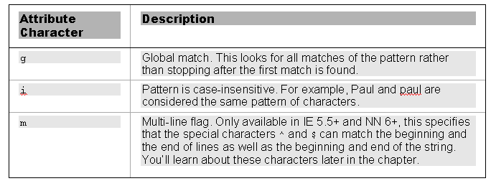
RegExp object
Attributes:
Notes:
By default the RegExp object only looks for the first matching pattern and then stops. This is common and important behavior for RegExp objects. Regular expressions tend to start at one end of a string and look through the characters until the first complete match is found, then stop. You can do a global match by using an attribute of the RegExp object.
This object also has two other attributes that can be used to do a case-insensitive match or a multiline match.

Slide 12
RegExp object
Attributes:
var myRegExp = /January/gi;
Notes:
(Code sample equivalent to book)
In this code, a global, case-insensitive match will be made.

Slide 13
What special characters are available in regular expressions?
The key to making regular expressions work is to define exactly the pattern of characters so that only that pattern can match and no other.

Slide 14
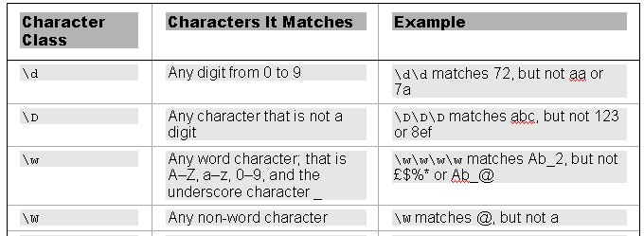
What special characters are available in regular expressions?
Special Characters for text, numbers, and punctuation:
Notes:
This group of special characters includes characters for digits, letters, and white space characters.

Slide 15
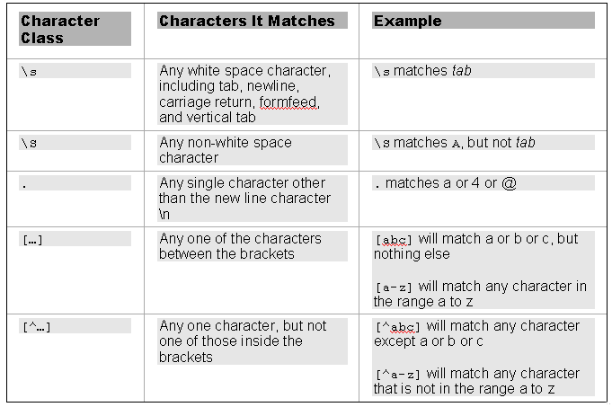
What special characters are available in regular expressions?

Slide 16
What special characters are available in regular expressions?
var myRegExp = /[^a-z\d ]/i
Notes:
What you want to find out with this regular expression is whether your string contains any characters that are not letters between A–Z and a–z, numbers between 0–9, or a space.

Slide 17
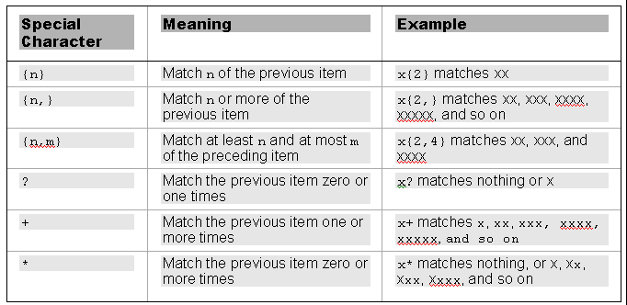
What special characters are available in regular expressions?
Repetition Characters:
Notes:
The repetition characters are a way of specifying how many of the last item or character you want to match.

Slide 18
What special characters are available in regular expressions?
Repetition Characters:
var myRegExp =
/\d-\d{3}-\d{3}-\d{4}/
Notes:
To match a telephone number in the format 1-800-888-5474, the regular expression would be
var myRegExp = /\d-\d{3}-\d{3}-\d{4}/

Slide 19
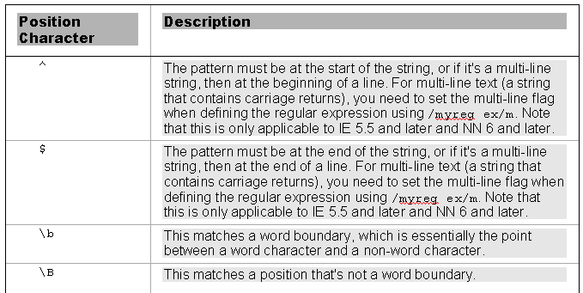
What special characters are available in regular expressions?
Position Characters:
Notes:
Position characters allow you to specify either where the match should start or end or what will be on either side of the character pattern. For example, you might want your pattern to exist at the start or end of a string or line, or you might want it to be between two words.

Slide 20
What special characters are available in regular expressions?
Position Characters:
var myRegExp = /\b/;
Notes:
(Code sample equivalent to book)
This regular expression defines the first occurrence of a word boundary (point between a word character and a non-word character).
If you wanted to make sure your pattern was at the start of a line, you would type the following:
^myPattern
This would match an occurrence of myPattern if it was at the beginning of a line.
To match the same pattern, but at the end of a line, you would type the following:
myPattern$

Slide 21
How are regular expressions grouped?
Parentheses in regular expressions are special characters that group together character patterns and are not themselves part of the characters to be matched.
var myRegExp = /\b(VB)?\b/gi;
Notes:
Why would you want to do this? Well, by grouping characters into patterns, you can use the special repetition characters to apply to the whole group of characters, rather than just one.
This regular expression defines a pattern of the word VB zero or more times.

Slide 22
How are regular expressions grouped?
var myRegExp = /\b(VB|Java)?\b/gi;
Notes:
The special character | is the alternation character. It has an "or"-like meaning, similar to using || in if statements, and will match the characters on either side of itself.
This regular expression defines a pattern of the word VB or the word Java zero or more times.

Slide 23
How are regular expressions grouped?
Reusing Groups of Characters:
- to refer to a previous group of characters, you just type \ and the order of the group. For example, the first group can be referred to as \1, the second as \2, and so on.

Slide 24

How are regular expressions grouped?
Reusing Groups of Characters:
Notes:
This regular expression defines a pattern of any series of digits followed by a comma, and then by the same pattern of characters as found in the first group.
The alert box will show
ERROR,001,ERROR,003,002,004

Slide 25
How are String methods used with regular expressions?
The main methods making use of regular expressions are these String object methods:
split()
replace()
search()
match()

Slide 26
How are String methods used with regular expressions?
split()
var myListString = "apple, 0.99, banana, 0.50, peach, 0.25, orange, 0.75";
var theRegExp = /[^a-z]+/i;
var myFruitArray = myListString.split(theRegExp);
Notes:
The split() method allows us to split a string into various pieces with the split being made at the character or characters specified as a parameter. The result of this method is an array with each element containing one of the split pieces.
This regular expression defines a pattern of one or more characters that are not between a and z.
The split method is used here to split the myListString so that the fruit names are retrieved but not the numbers.

Slide 27
How are String methods used with regular expressions?
replace()
var myString = "1999, 2000, 2001";
var myRegExp = /(\d{4})/g;
myString = myString.replace(myRegExp, "the year $1");
Notes:
The replace() method has the ability to replace text based on the groups matched in the regular expression. You do this using the $ sign and the group's number. Each group in a regular expression is given a number from 1 to 99; any groups greater than 99 are not accessible. Note that in earlier browsers, groups could only go from 1 to 9 (for example, in IE 5 or earlier or Netscape 4 and earlier). To refer to a group, you write $ followed by the group's position.
The variable myString would then contain the required string "the year 1999, the year 2000, the year 2001".

Slide 28
How are String methods used with regular expressions?
search()
var myString = "Beginning JavaScript, Beginning Java 2, Professional JavaScript";
var myRegExp = /\bJava\b/i;
alert(myString.search(myRegExp));
Notes:
The search() method allows you to search a string for a pattern of characters. If the pattern is found, the character position at which it was found is returned; otherwise, –1 is returned. The method takes only one parameter, the RegExp object you have created.
While for basic searches the indexOf() method is fine, if you want more complex searches, such as a pattern of any digits or where a word must be in between a certain boundary, then search() provides a much more powerful and flexible, but sometimes more complex, approach.
Note that with the search() method, the g for global is not relevant, and its use has no effect.

Slide 29
How are String methods used with regular expressions?
match()
var myString = "The years were 1999, 2000 and 2001";
var myRegExp = /\b\d{4}\b/g;
var resultsArray = myString.match(myRegExp);
Notes:
The match() method is very similar to the search() method, except that instead of returning the position where a match was found, it returns an array. Each element of the array contains the text of a match made.
This code would return an array (resultsArray) with 3 items (1999, 2000, and 2001).

Slide 30
Using the RegExp Object's Constructor
RegExp literal:
var myRegExp = /[a-z]/;
RegExp constructor:
var myRegExp = new RegExp("[a-z]");
Notes:
A very important difference when using this method is in how you use special regular expression characters, such as \b, which have a backward slash in front of them. The problem is that the backward slash indicates an escape character in JavaScript strings—for example, you may use \b, which means a backspace. To differentiate between \b meaning a backspace in a string and the \b special character in a regular expression, you have to put another backward slash in front of the regular expression special character. So \b becomes \\b when you mean the regular expression \b that matches a word boundary rather than a backspace character.
All special regular expression characters, such as \w, \b, \d, and so on, must have an extra \ in front when created using RegExp().
The optional second parameter of the RegExp() constructor takes the flags that specify a global or case-insensitive match. For example,
var myRegExp = new RegExp("hello\\b","gi");
will do a global case-insensitive pattern match.

